Slide 1

SRM INSTITUTE OF SCIENCE AND TECHNOLOGY
RAMAPURAM
DEPARTMENT OF COMPUTER SCIENCE AND ENGINEERING
21GNP301L- COMMUNITY CONNECT
Student Details
Name: R.VishnuTharan,
Reg No.: RA2411003020368
Class & Dept : B.Tech CSE F
Course Incharge Details
Dr. Saraswathi
Assistant Professor
CSE SRM IST

Slide 2
Presentation overview:
Course Overview
About the Organization
Objective of choosing the specific organization
Nature of Activities of the organization
Week-wise activity undertaken
Tangible learning
Student contribution to organization during the service period:certificate

Slide 3
Course overview
Need of the Course: Community Connect is designed to in still social responsibility and civic engagement in engineering students by involving them directly in community/digital surveying service. It bridges classroom learning with real-world impact.
Organization Details: Pro-Vision — an public charitable trust empowering children, women and persons with disabilities through sustainable development.
Duration of Course: 8 weeks (mention your actual start–end dates), conducted as part of the 21GNP301L curriculum.

Slide 4
ABOUT THE ORGANIZATION:
Overview:
❖ Pro-Vision (Organization) is a registered trust based in Kanyakumari District, working to raise public awareness about the community development, empowering marginalized groups and conducting digital surveys.

Slide 5
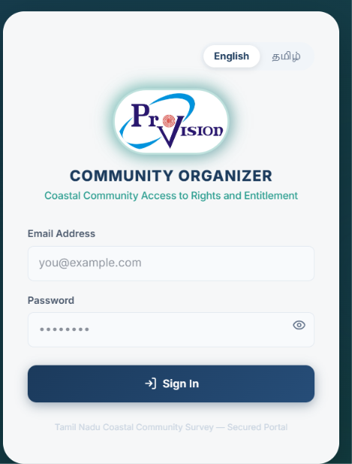
ABOUT THE ORGANIZATION:
Core Focus Areas:
❖ Digital Surveying: Building a Household Survey app for accurate demographic data collection.

Slide 6
Objective of choosing the specific organization
Why This Organization?
❖ Pro-Vision was chosen because its digital initiatives offered a chance to develop a real-world Household Survey application, rather than purely donation-based involvement.
❖ Its structured, recurring field activities (rather than one-off events) made it possible to track progress and contribution across the full 8-week service period.
❖ The Organization's presence within Chennai made regular, in-person participation logistically practical for a student volunteer.

Slide 7
Objective of choosing the specific organization
Personal and Academic Objectives:
❖ To apply classroom knowledge of sustainability and digital surveying science to real ground-level action.

Slide 8
Objective of choosing the specific organization
Broader Motivation:
❖ Inspired by founder the Board of Trustees's story of building an impact-driven organization despite personal challenges.
❖ Aimed to build a long-term habit of digital surveying responsibility that continues beyond the course requirement.

Slide 9
Nature of ACTIVITies of the organization
Overview of the Four Verticals:
Pro-Vision runs initiatives across four core verticals: Community Development, Digital Literacy, Health & Education.
❖ Each vertical combines awareness-building with direct, on-ground action rather than fundraising alone.
❖ This structure allows the Organization to address interconnected community needs, not just isolated causes.

Slide 10
Nature of Activities of the organization
Digital Surveying Vertical (Primary Focus):
Designing survey logic and offline forms to capture local demographic data efficiently.
Developing mobile and web interfaces for data entry workers to manage records.
Creating centralized databases to synchronize collected data seamlessly.
Implementing robust authentication systems to ensure data security and privacy.

Slide 11
Nature of Activities of the organization
Other Verticals (Education, Sustainable Development, Health):
Education: Free tuition, scholarships for marginalized students, school-supply distribution drives, exam-fear training programs.
Sustainable Development: Youth Development Training, capacity-building programs, employment fairs for the unemployed in slum areas.
Health: Medical camps, child health and hygiene awareness, advice sessions for mothers supported by doctors.
While broader in scope, these verticals reflect the Organization's holistic community-development approach.

Slide 12
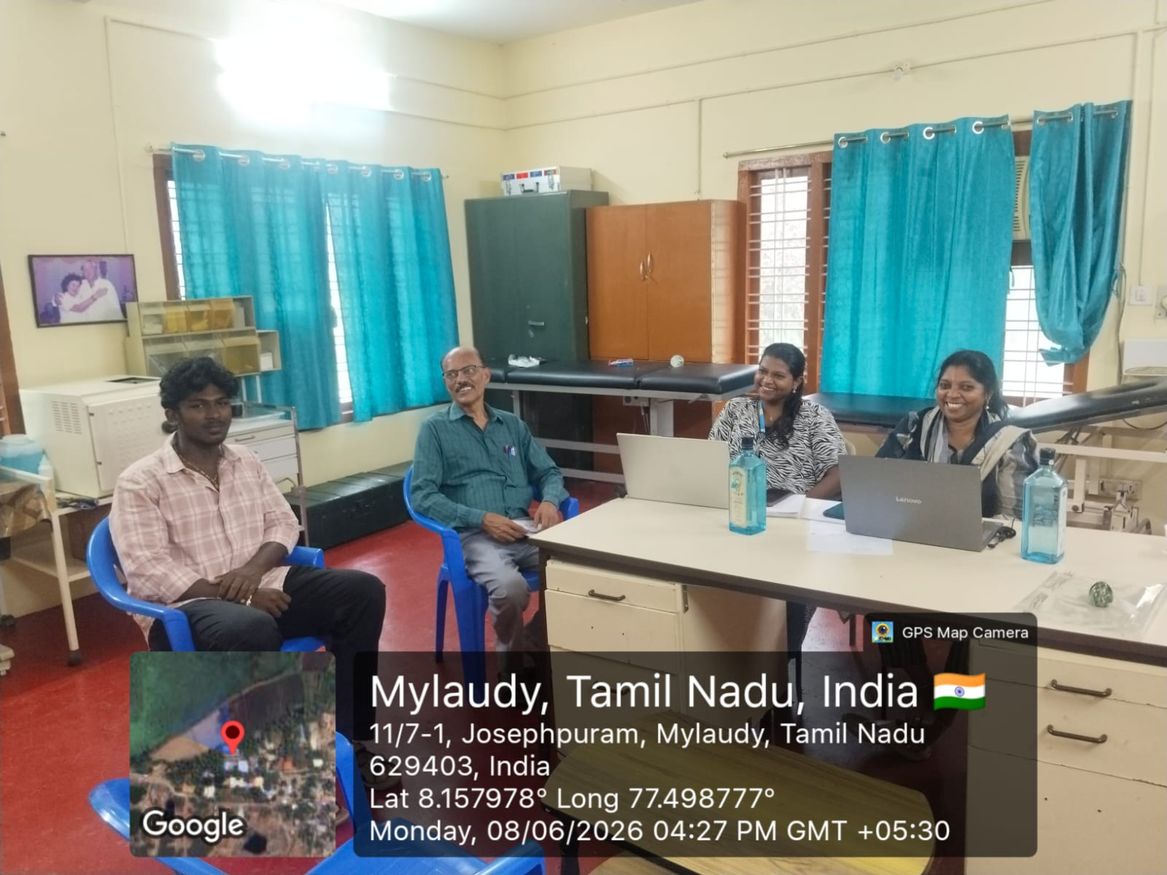
Week-wise activity undertaken
Week 1 & 2: Analyzed Pro-Vision's requirements for household data collection and designed the application architecture and database schema.

Slide 13
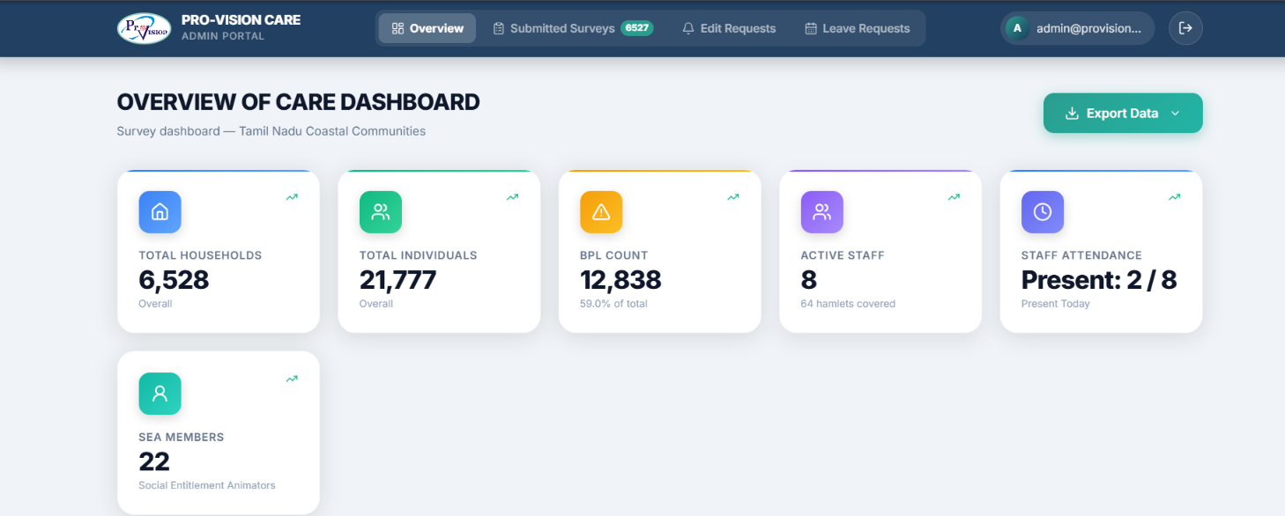
Week-wise activity undertaken
Week 3 & 4: Developed the frontend UI for the Household Survey app, implementing complex forms for capturing demographic data.

Slide 14
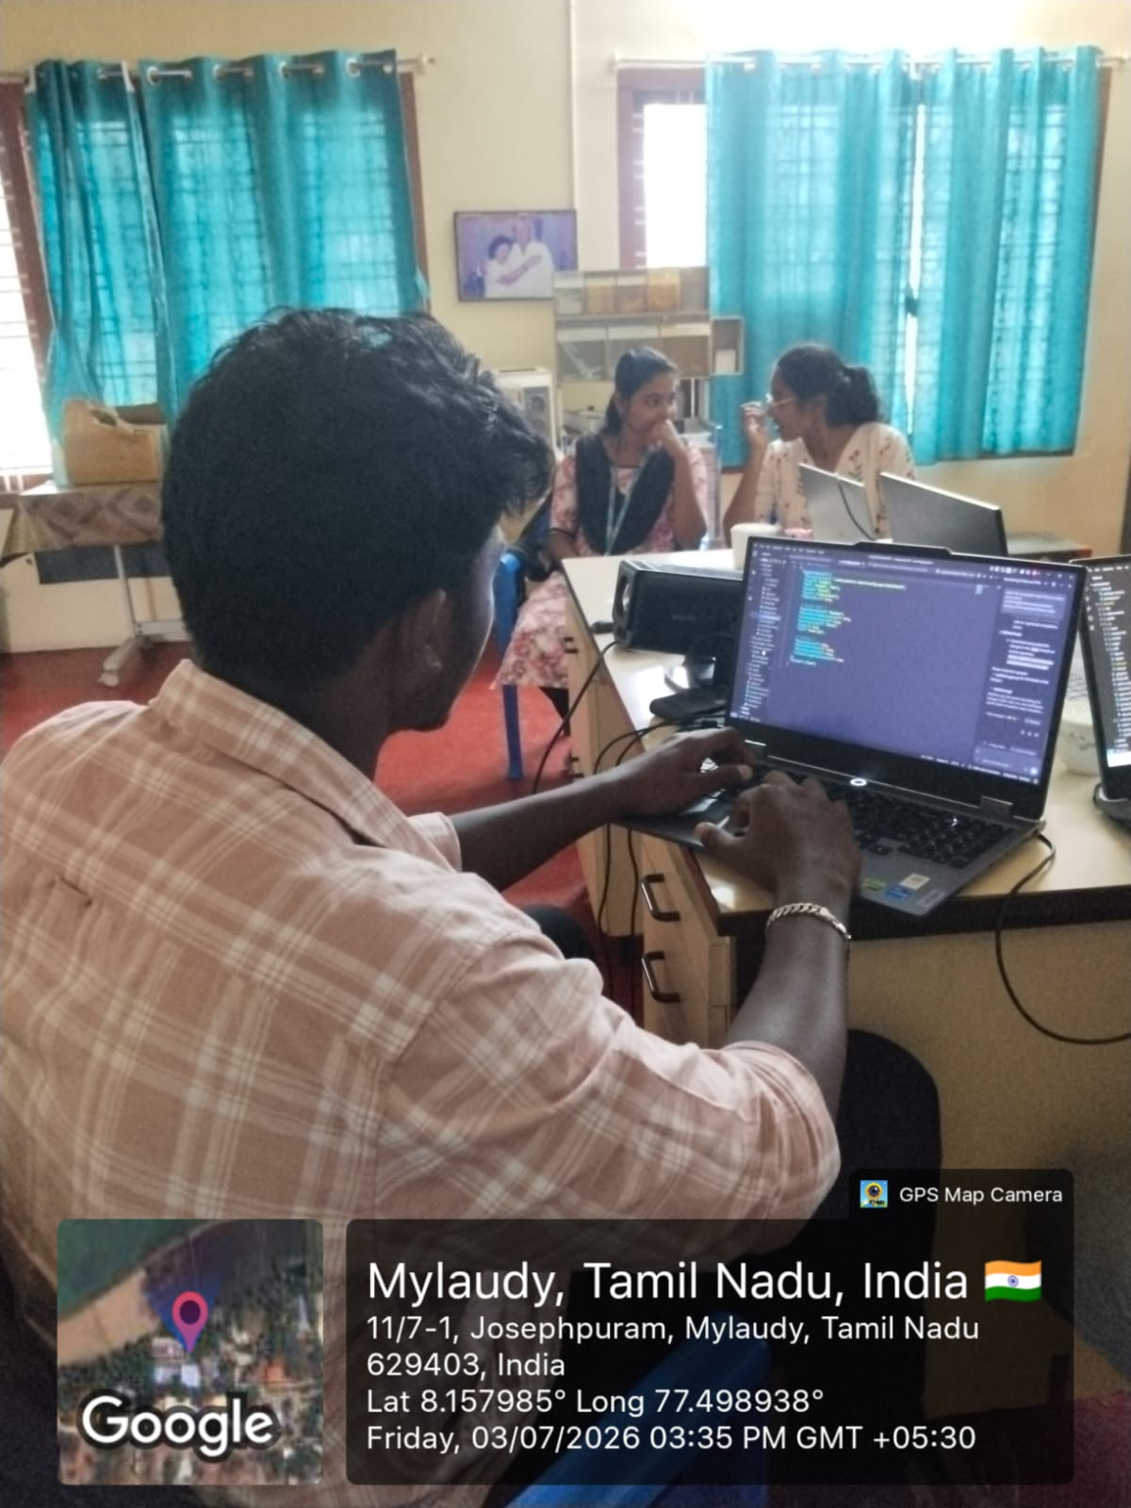
Week-wise activity undertaken
Week 5 & 6: Integrated the backend API with the database, ensuring secure storage of sensitive household information.

Slide 15
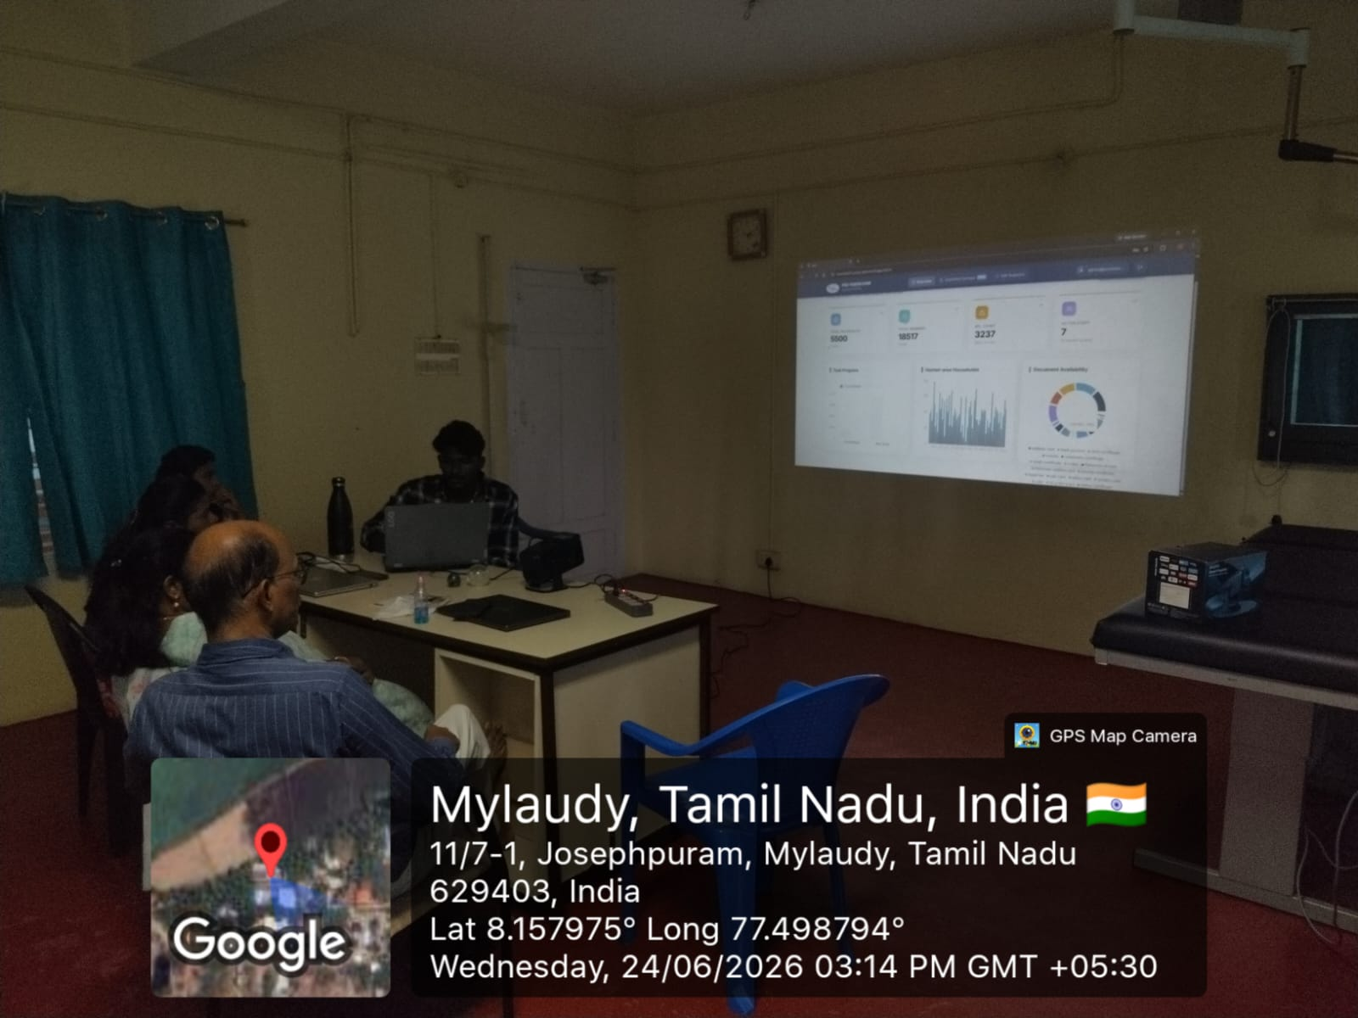
Week-wise activity undertaken
Week 7 & 8: Conducted rigorous testing, fixed bugs, and demonstrated the completed Household Survey app to the organization.

Slide 16
Tangible learning
Technical/Practical Learning:
Understood real ground-level digital surveying challenges (offline data sync, complex form handling, and user authentication) not always evident from textbook study.
Learned to test application stability and manage deployment requirements.

Slide 17
Tangible learning
Interpersonal & Soft Skills:
❖ Developed teamwork and coordination skills working alongside Organization volunteers and community members from diverse backgrounds.
❖ Built confidence in organizing and leading small group activities in the field.

Slide 18
Tangible learning
Personal & Civic Growth:
❖ Developed a lasting sense of digital surveying and civic responsibility that extends beyond the course requirement.

Slide 19
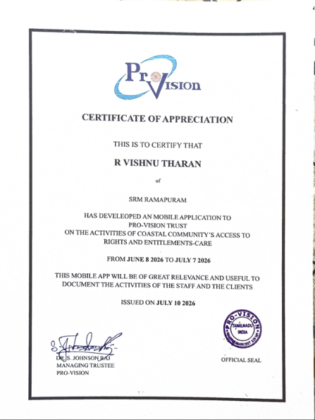
certificate

Slide 20
THANK YOU

